Slide 1
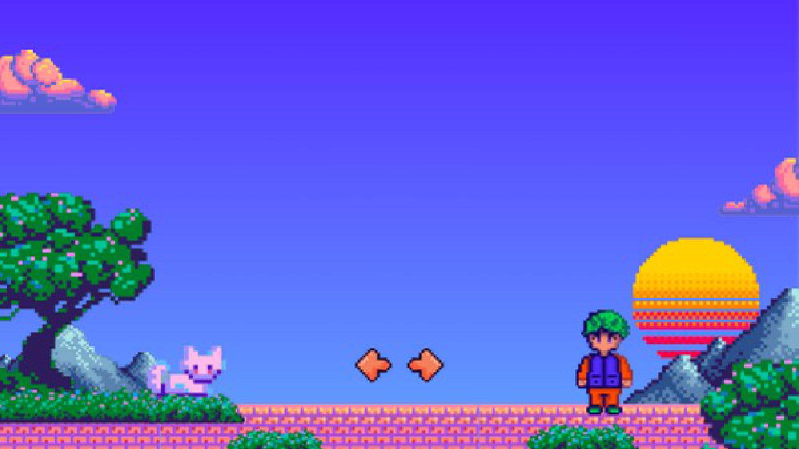
ТАБЛИЦЫ / ВАРИАНТЫ
18 способов оформить
твои таблицы
Прежние пиксельные фоны. Разные композиции,
отступы, заголовки и акценты.
01–12
13–16
17–18
Второй слайд
10 форматов
Команда
Три формата, двенадцать вариантов
Четыре оформления плотной таблицы
Два варианта распределения задач
Открой варианты и выбери номера, которые нравятся.

Slide 2
01 / Чистая классика
Part A — Multimedia formats
PNG / JPEG / WebP — same content, different table layouts
FORMAT | KEY TRAIT | BEST FIT
PNG | Lossless; supports transparency | Screenshots and graphics with crisp text or edges
JPEG | Lossy; compact for photographs | Photos where a smaller file matters more than perfect detail
WebP | Lossy or lossless; compact | Web images and the attendance preview in our prototype
In our prototype: WebP preview + inline SVG interface icons.
Контрастная шапка, свободные поля и спокойные строки.
01
Notes:
Вариант 1: Чистая классика. Контрастная шапка, свободные поля и спокойные строки.
Original pixel-art background preserved. Editable table/text/shape objects. Visual references: https://www.canva.com/templates/s/table/ ; https://www.canva.com/graphs/tables/ . Independent layout inspired by these examples, not a copied Canva template.
PNG | Lossless; supports transparency | Screenshots and graphics with crisp text or edges
JPEG | Lossy; compact for photographs | Photos where a smaller file matters more than perfect detail
WebP | Lossy or lossless; compact | Web images and the attendance preview in our prototype

Slide 3
02 / Строки-карточки
Part A — Multimedia formats
PNG / JPEG / WebP — same content, different table layouts
FORMAT
KEY TRAIT
BEST FIT
Lossless; supports transparency
Screenshots and graphics with crisp text or edges
PNG
Lossy; compact for photographs
Photos where a smaller file matters more than perfect detail
JPEG
Lossy or lossless; compact
Web images and the attendance preview in our prototype
WebP
In our prototype: WebP preview + inline SVG interface icons.
Каждая строка отделена от соседних; форматы видны сразу.
02
Notes:
Вариант 2: Строки-карточки. Каждая строка отделена от соседних; форматы видны сразу.
Original pixel-art background preserved. Editable table/text/shape objects. Visual references: https://www.canva.com/templates/s/table/ ; https://www.canva.com/graphs/tables/ . Independent layout inspired by these examples, not a copied Canva template.
PNG | Lossless; supports transparency | Screenshots and graphics with crisp text or edges
JPEG | Lossy; compact for photographs | Photos where a smaller file matters more than perfect detail
WebP | Lossy or lossless; compact | Web images and the attendance preview in our prototype

Slide 4
03 / Пастельные колонки
Part A — Multimedia formats
PNG / JPEG / WebP — same content, different table layouts
COMPARE | PNG | JPEG | WebP
Key trait | Lossless; supports transparency | Lossy; compact for photographs | Lossy or lossless; compact
Best fit | Screenshots and graphics with crisp text or edges | Photos where a smaller file matters more than perfect detail | Web images and the attendance preview in our prototype
In our prototype: WebP preview + inline SVG interface icons.
Один формат — одна цветная колонка.
03
Notes:
Вариант 3: Пастельные колонки. Один формат — одна цветная колонка.
Original pixel-art background preserved. Editable table/text/shape objects. Visual references: https://www.canva.com/templates/s/table/ ; https://www.canva.com/graphs/tables/ . Independent layout inspired by these examples, not a copied Canva template.
PNG | Lossless; supports transparency | Screenshots and graphics with crisp text or edges
JPEG | Lossy; compact for photographs | Photos where a smaller file matters more than perfect detail
WebP | Lossy or lossless; compact | Web images and the attendance preview in our prototype

Slide 5
04 / Три карточки
Part A — Multimedia formats
PNG / JPEG / WebP — same content, different table layouts
PNG
JPEG
WebP
KEY TRAIT
KEY TRAIT
KEY TRAIT
Lossless; supports transparency
Lossy; compact for photographs
Lossy or lossless; compact
BEST FIT
BEST FIT
BEST FIT
Screenshots and graphics with crisp text or edges
Photos where a smaller file matters more than perfect detail
Web images and the attendance preview in our prototype
In our prototype: WebP preview + inline SVG interface icons.
Свойства и применение собраны в трёх независимых карточках.
04
Notes:
Вариант 4: Три карточки. Свойства и применение собраны в трёх независимых карточках.
Original pixel-art background preserved. Editable table/text/shape objects. Visual references: https://www.canva.com/templates/s/table/ ; https://www.canva.com/graphs/tables/ . Independent layout inspired by these examples, not a copied Canva template.
PNG | Lossless; supports transparency | Screenshots and graphics with crisp text or edges
JPEG | Lossy; compact for photographs | Photos where a smaller file matters more than perfect detail
WebP | Lossy or lossless; compact | Web images and the attendance preview in our prototype

Slide 6
05 / Акцент на WebP
Part A — Multimedia formats
PNG / JPEG / WebP — same content, different table layouts
COMPARE | PNG | JPEG | WebP
Key trait | Lossless; supports transparency | Lossy; compact for photographs | Lossy or lossless; compact
Best fit | Screenshots and graphics with crisp text or edges | Photos where a smaller file matters more than perfect detail | Web images and the attendance preview in our prototype
In our prototype: WebP preview + inline SVG interface icons.
Выделена колонка формата, выбранного для проекта.
05
Notes:
Вариант 5: Акцент на WebP. Выделена колонка формата, выбранного для проекта.
Original pixel-art background preserved. Editable table/text/shape objects. Visual references: https://www.canva.com/templates/s/table/ ; https://www.canva.com/graphs/tables/ . Independent layout inspired by these examples, not a copied Canva template.
PNG | Lossless; supports transparency | Screenshots and graphics with crisp text or edges
JPEG | Lossy; compact for photographs | Photos where a smaller file matters more than perfect detail
WebP | Lossy or lossless; compact | Web images and the attendance preview in our prototype

Slide 7
06 / Тонкие линии
Part A — Multimedia formats
PNG / JPEG / WebP — same content, different table layouts
FORMAT
KEY TRAIT
BEST FIT
PNG
Lossless; supports transparency
Screenshots and graphics with crisp text or edges
JPEG
Lossy; compact for photographs
Photos where a smaller file matters more than perfect detail
WebP
Lossy or lossless; compact
Web images and the attendance preview in our prototype
In our prototype: WebP preview + inline SVG interface icons.
Лёгкая таблица без вертикальной сетки.
06
Notes:
Вариант 6: Тонкие линии. Лёгкая таблица без вертикальной сетки.
Original pixel-art background preserved. Editable table/text/shape objects. Visual references: https://www.canva.com/templates/s/table/ ; https://www.canva.com/graphs/tables/ . Independent layout inspired by these examples, not a copied Canva template.
PNG | Lossless; supports transparency | Screenshots and graphics with crisp text or edges
JPEG | Lossy; compact for photographs | Photos where a smaller file matters more than perfect detail
WebP | Lossy or lossless; compact | Web images and the attendance preview in our prototype

Slide 8
07 / Тёмная таблица
Part A — Multimedia formats
PNG / JPEG / WebP — same content, different table layouts
FORMAT | KEY TRAIT | BEST FIT
PNG | Lossless; supports transparency | Screenshots and graphics with crisp text or edges
JPEG | Lossy; compact for photographs | Photos where a smaller file matters more than perfect detail
WebP | Lossy or lossless; compact | Web images and the attendance preview in our prototype
In our prototype: WebP preview + inline SVG interface icons.
Светлый текст и бирюзовые детали на тёмной поверхности.
07
Notes:
Вариант 7: Тёмная таблица. Светлый текст и бирюзовые детали на тёмной поверхности.
Original pixel-art background preserved. Editable table/text/shape objects. Visual references: https://www.canva.com/templates/s/table/ ; https://www.canva.com/graphs/tables/ . Independent layout inspired by these examples, not a copied Canva template.
PNG | Lossless; supports transparency | Screenshots and graphics with crisp text or edges
JPEG | Lossy; compact for photographs | Photos where a smaller file matters more than perfect detail
WebP | Lossy or lossless; compact | Web images and the attendance preview in our prototype

Slide 9
08 / Пиксельное окно
Part A — Multimedia formats
PNG / JPEG / WebP — same content, different table layouts
MEDIA_FORMATS
FORMAT | KEY TRAIT | BEST FIT
PNG | Lossless; supports transparency | Screenshots and graphics with crisp text or edges
JPEG | Lossy; compact for photographs | Photos where a smaller file matters more than perfect detail
WebP | Lossy or lossless; compact | Web images and the attendance preview in our prototype
In our prototype: WebP preview + inline SVG interface icons.
Таблица внутри окна в стиле исходного пиксельного фона.
08
Notes:
Вариант 8: Пиксельное окно. Таблица внутри окна в стиле исходного пиксельного фона.
Original pixel-art background preserved. Editable table/text/shape objects. Visual references: https://www.canva.com/templates/s/table/ ; https://www.canva.com/graphs/tables/ . Independent layout inspired by these examples, not a copied Canva template.
PNG | Lossless; supports transparency | Screenshots and graphics with crisp text or edges
JPEG | Lossy; compact for photographs | Photos where a smaller file matters more than perfect detail
WebP | Lossy or lossless; compact | Web images and the attendance preview in our prototype

Slide 10
09 / Отдельные ячейки
Part A — Multimedia formats
PNG / JPEG / WebP — same content, different table layouts
FORMAT
KEY TRAIT
BEST FIT
PNG
Lossless; supports transparency
Screenshots and graphics with crisp text or edges
JPEG
Lossy; compact for photographs
Photos where a smaller file matters more than perfect detail
WebP
Lossy or lossless; compact
Web images and the attendance preview in our prototype
In our prototype: WebP preview + inline SVG interface icons.
Мягкие ячейки с промежутками вместо сплошной сетки.
09
Notes:
Вариант 9: Отдельные ячейки. Мягкие ячейки с промежутками вместо сплошной сетки.
Original pixel-art background preserved. Editable table/text/shape objects. Visual references: https://www.canva.com/templates/s/table/ ; https://www.canva.com/graphs/tables/ . Independent layout inspired by these examples, not a copied Canva template.
PNG | Lossless; supports transparency | Screenshots and graphics with crisp text or edges
JPEG | Lossy; compact for photographs | Photos where a smaller file matters more than perfect detail
WebP | Lossy or lossless; compact | Web images and the attendance preview in our prototype

Slide 11
10 / Цветные вкладки
Part A — Multimedia formats
PNG / JPEG / WebP — same content, different table layouts
KEY TRAIT
BEST FIT
PNG
Lossless; supports transparency
Screenshots and graphics with crisp text or edges
KEY TRAIT
BEST FIT
JPEG
Lossy; compact for photographs
Photos where a smaller file matters more than perfect detail
KEY TRAIT
BEST FIT
WebP
Lossy or lossless; compact
Web images and the attendance preview in our prototype
In our prototype: WebP preview + inline SVG interface icons.
Форматы вынесены в цветные вкладки слева.
10
Notes:
Вариант 10: Цветные вкладки. Форматы вынесены в цветные вкладки слева.
Original pixel-art background preserved. Editable table/text/shape objects. Visual references: https://www.canva.com/templates/s/table/ ; https://www.canva.com/graphs/tables/ . Independent layout inspired by these examples, not a copied Canva template.
PNG | Lossless; supports transparency | Screenshots and graphics with crisp text or edges
JPEG | Lossy; compact for photographs | Photos where a smaller file matters more than perfect detail
WebP | Lossy or lossless; compact | Web images and the attendance preview in our prototype

Slide 12
11 / Таблица с пояснением
Part A — Multimedia formats
PNG / JPEG / WebP — same content, different table layouts
Different files.
Different jobs.
FORMAT | KEY TRAIT | BEST FIT
PNG | Lossless; supports transparency | Screenshots and graphics with crisp text or edges
JPEG | Lossy; compact for photographs | Photos where a smaller file matters more than perfect detail
WebP | Lossy or lossless; compact | Web images and the attendance preview in our prototype
Choose a format
for the content
and its use.
WEBP IN OUR APP
In our prototype: WebP preview + inline SVG interface icons.
Краткий вывод слева, компактное сравнение справа.
11
Notes:
Вариант 11: Таблица с пояснением. Краткий вывод слева, компактное сравнение справа.
Original pixel-art background preserved. Editable table/text/shape objects. Visual references: https://www.canva.com/templates/s/table/ ; https://www.canva.com/graphs/tables/ . Independent layout inspired by these examples, not a copied Canva template.
PNG | Lossless; supports transparency | Screenshots and graphics with crisp text or edges
JPEG | Lossy; compact for photographs | Photos where a smaller file matters more than perfect detail
WebP | Lossy or lossless; compact | Web images and the attendance preview in our prototype

Slide 13
12 / Крупная нумерация
Part A — Multimedia formats
PNG / JPEG / WebP — same content, different table layouts
01
PNG
Lossless; supports transparency
Screenshots and graphics with crisp text or edges
02
JPEG
Lossy; compact for photographs
Photos where a smaller file matters more than perfect detail
03
WebP
Lossy or lossless; compact
Web images and the attendance preview in our prototype
In our prototype: WebP preview + inline SVG interface icons.
Крупные номера задают порядок чтения.
12
Notes:
Вариант 12: Крупная нумерация. Крупные номера задают порядок чтения.
Original pixel-art background preserved. Editable table/text/shape objects. Visual references: https://www.canva.com/templates/s/table/ ; https://www.canva.com/graphs/tables/ . Independent layout inspired by these examples, not a copied Canva template.
PNG | Lossless; supports transparency | Screenshots and graphics with crisp text or edges
JPEG | Lossy; compact for photographs | Photos where a smaller file matters more than perfect detail
WebP | Lossy or lossless; compact | Web images and the attendance preview in our prototype

Slide 14
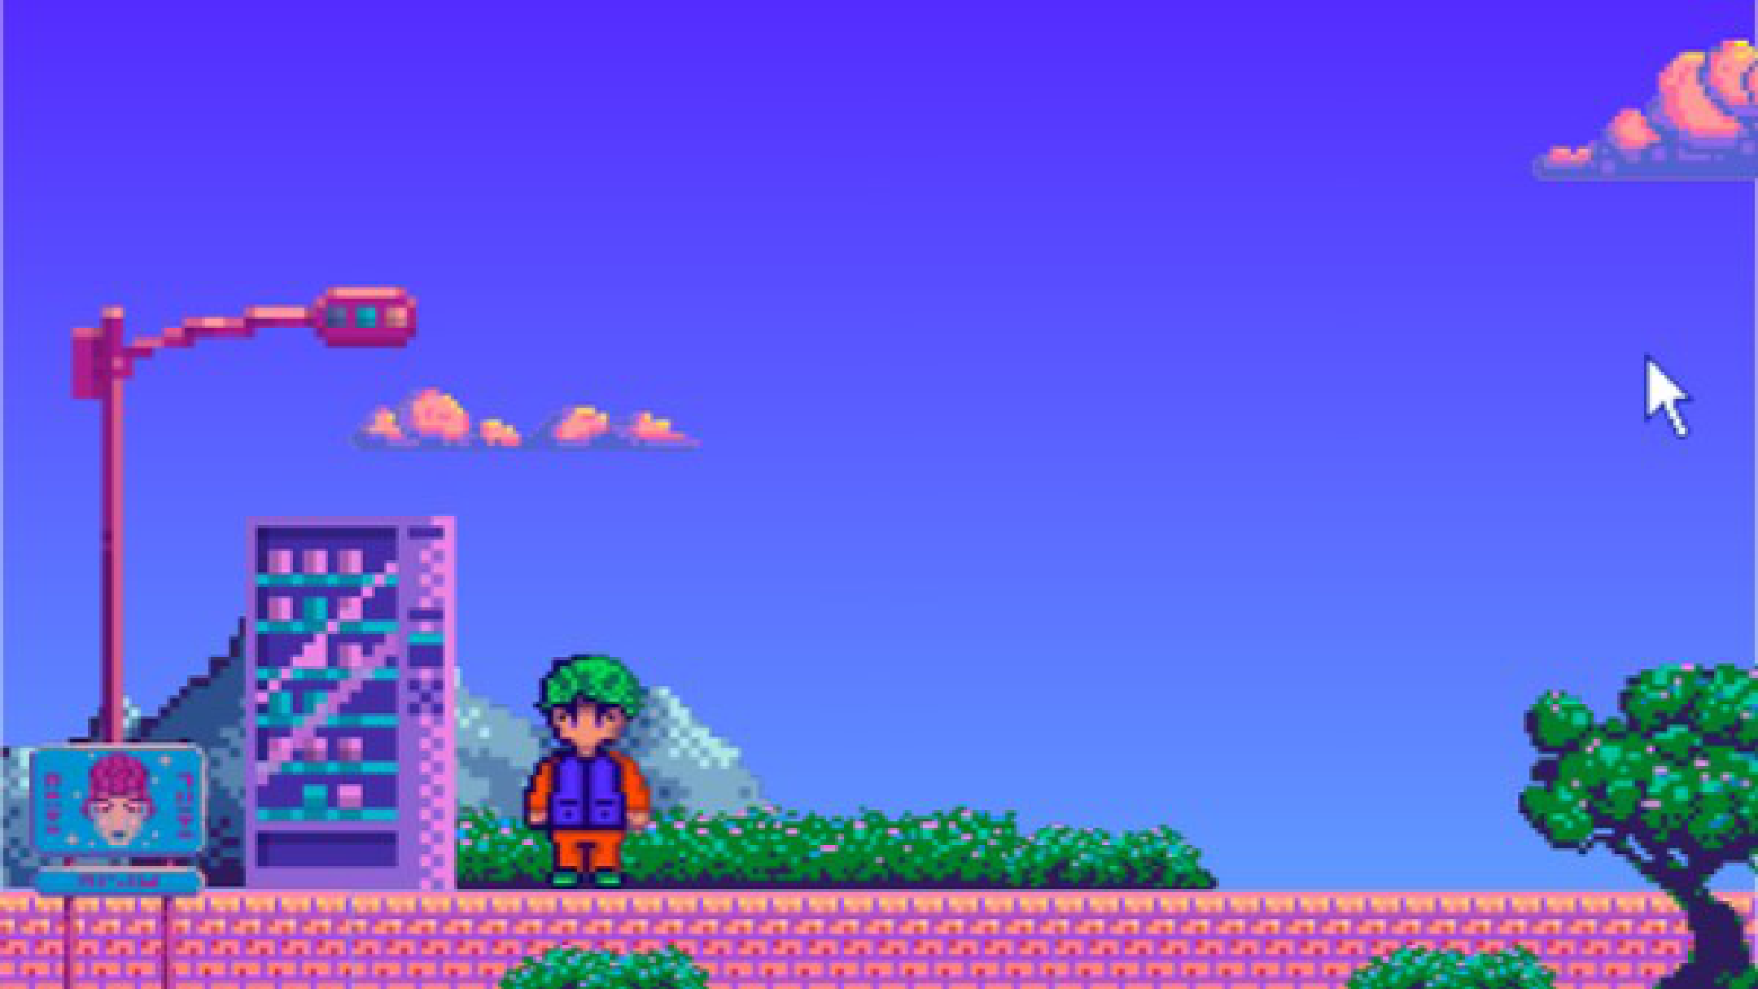
13 / Плотная: светлая
A1. Format comparison
FORMAT | TYPE | COMPRESSION | ALPHA / MOTION | TYPICAL SIZE | SUPPORT | PROJECT USE
PNG | Image | Lossless | Alpha; APNG | Large photos | Broad | UI evidence
JPEG | Image | Lossy | Neither | Small photos | Broad | Photos
WebP | Image | Both modes | Alpha + motion | Compact | Modern | App preview
SVG | Image | Vector / text | Alpha + motion | Tiny icons | Broad | UI icons
MP3 | Audio | Lossy | N/A | Small | Broad | Speech / music
AAC (M4A) | Audio | Lossy | N/A | Small | Broad* | Narration
WAV (PCM) | Audio | Uncompressed | N/A | Large | Broad* | Editing master
MP4 H.264 | Video | Usually lossy | Motion; no alpha | Bitrate-based | Broad* | Demo delivery
WebM VP9 | Video | Usually lossy | Motion; alpha* | Bitrate-based | Modern* | Web playback
MOV H.264 | Video | Usually lossy | Motion; no alpha | Bitrate-based | Limited web | Editing / transfer
Container = package. Codec = how the media is encoded.
*Support varies by codec, OS and device. File size depends on content and encoding.
Все 10 форматов и 7 исходных полей на одном слайде.
13
Notes:
Вариант 13: Плотная: светлая. Все 10 форматов и 7 исходных полей на одном слайде.
Original pixel-art background preserved. Editable table/text/shape objects. Visual references: https://www.canva.com/templates/s/table/ ; https://www.canva.com/graphs/tables/ . Independent layout inspired by these examples, not a copied Canva template.

Slide 15
14 / Плотная: по группам
A1. Format comparison
FORMAT
TYPE
COMPRESSION
ALPHA / MOTION
TYPICAL SIZE
SUPPORT
PROJECT USE
PNG
Image
Lossless
Alpha; APNG
Large photos
Broad
UI evidence
JPEG
Image
Lossy
Neither
Small photos
Broad
Photos
WebP
Image
Both modes
Alpha + motion
Compact
Modern
App preview
SVG
Image
Vector / text
Alpha + motion
Tiny icons
Broad
UI icons
MP3
Audio
Lossy
N/A
Small
Broad
Speech / music
AAC (M4A)
Audio
Lossy
N/A
Small
Broad*
Narration
WAV (PCM)
Audio
Uncompressed
N/A
Large
Broad*
Editing master
MP4 H.264
Video
Usually lossy
Motion; no alpha
Bitrate-based
Broad*
Demo delivery
WebM VP9
Video
Usually lossy
Motion; alpha*
Bitrate-based
Modern*
Web playback
MOV H.264
Video
Usually lossy
Motion; no alpha
Bitrate-based
Limited web
Editing / transfer
Container = package. Codec = how the media is encoded.
*Support varies by codec, OS and device. File size depends on content and encoding.
Изображения, аудио и видео разделены внутри одной таблицы.
14
Notes:
Вариант 14: Плотная: по группам. Изображения, аудио и видео разделены внутри одной таблицы.
Original pixel-art background preserved. Editable table/text/shape objects. Visual references: https://www.canva.com/templates/s/table/ ; https://www.canva.com/graphs/tables/ . Independent layout inspired by these examples, not a copied Canva template.

Slide 16
15 / Плотная: акцент на применении
A1. Format comparison
FORMAT | TYPE | COMPRESSION | ALPHA / MOTION | TYPICAL SIZE | SUPPORT | PROJECT USE
PNG | Image | Lossless | Alpha; APNG | Large photos | Broad | UI evidence
JPEG | Image | Lossy | Neither | Small photos | Broad | Photos
WebP | Image | Both modes | Alpha + motion | Compact | Modern | App preview
SVG | Image | Vector / text | Alpha + motion | Tiny icons | Broad | UI icons
MP3 | Audio | Lossy | N/A | Small | Broad | Speech / music
AAC (M4A) | Audio | Lossy | N/A | Small | Broad* | Narration
WAV (PCM) | Audio | Uncompressed | N/A | Large | Broad* | Editing master
MP4 H.264 | Video | Usually lossy | Motion; no alpha | Bitrate-based | Broad* | Demo delivery
WebM VP9 | Video | Usually lossy | Motion; alpha* | Bitrate-based | Modern* | Web playback
MOV H.264 | Video | Usually lossy | Motion; no alpha | Bitrate-based | Limited web | Editing / transfer
Container = package. Codec = how the media is encoded.
*Support varies by codec, OS and device. File size depends on content and encoding.
Колонка применения выделена; остальные поля сохранены.
15
Notes:
Вариант 15: Плотная: акцент на применении. Колонка применения выделена; остальные поля сохранены.
Original pixel-art background preserved. Editable table/text/shape objects. Visual references: https://www.canva.com/templates/s/table/ ; https://www.canva.com/graphs/tables/ . Independent layout inspired by these examples, not a copied Canva template.

Slide 17
16 / Плотная: тёмная
A1. Format comparison
FORMAT | TYPE | COMPRESSION | ALPHA / MOTION | TYPICAL SIZE | SUPPORT | PROJECT USE
PNG | Image | Lossless | Alpha; APNG | Large photos | Broad | UI evidence
JPEG | Image | Lossy | Neither | Small photos | Broad | Photos
WebP | Image | Both modes | Alpha + motion | Compact | Modern | App preview
SVG | Image | Vector / text | Alpha + motion | Tiny icons | Broad | UI icons
MP3 | Audio | Lossy | N/A | Small | Broad | Speech / music
AAC (M4A) | Audio | Lossy | N/A | Small | Broad* | Narration
WAV (PCM) | Audio | Uncompressed | N/A | Large | Broad* | Editing master
MP4 H.264 | Video | Usually lossy | Motion; no alpha | Bitrate-based | Broad* | Demo delivery
WebM VP9 | Video | Usually lossy | Motion; alpha* | Bitrate-based | Modern* | Web playback
MOV H.264 | Video | Usually lossy | Motion; no alpha | Bitrate-based | Limited web | Editing / transfer
Container = package. Codec = how the media is encoded.
*Support varies by codec, OS and device. File size depends on content and encoding.
Полная таблица с тёмным фоном и спокойной сеткой.
16
Notes:
Вариант 16: Плотная: тёмная. Полная таблица с тёмным фоном и спокойной сеткой.
Original pixel-art background preserved. Editable table/text/shape objects. Visual references: https://www.canva.com/templates/s/table/ ; https://www.canva.com/graphs/tables/ . Independent layout inspired by these examples, not a copied Canva template.

Slide 18
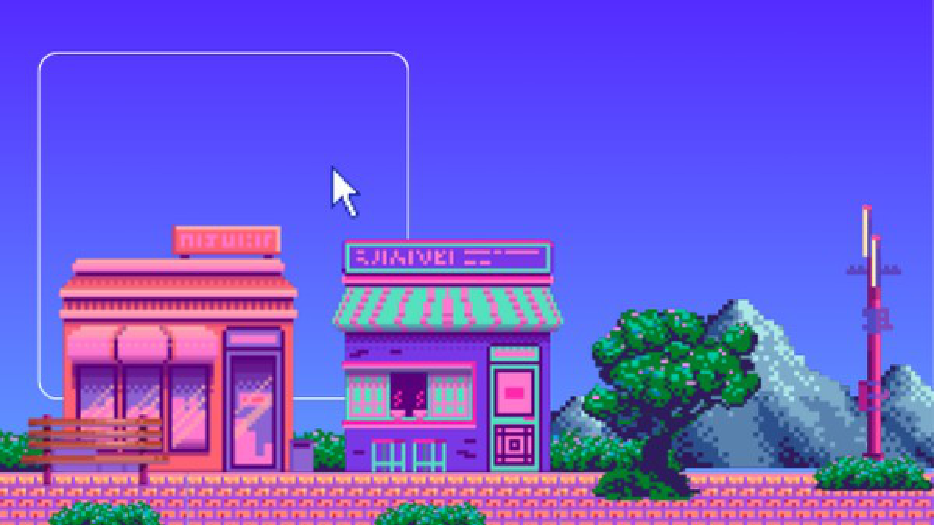
17 / Команда: карточки
D3. Team contributions
C, D
A, D
B, D
Salima
Azhar
Nurassyl
CONTRIBUTION
CONTRIBUTION
CONTRIBUTION
Editing the video
Comparing formats
Multimedia integration
Три человека — три самостоятельные карточки.
17
Notes:
Вариант 17: Команда: карточки. Три человека — три самостоятельные карточки.
Original pixel-art background preserved. Editable table/text/shape objects. Visual references: https://www.canva.com/templates/s/table/ ; https://www.canva.com/graphs/tables/ . Independent layout inspired by these examples, not a copied Canva template.

Slide 19
18 / Команда: таблица
D3. Team contributions
MEMBER | PARTS | CONTRIBUTION
Salima | C, D | Editing the video
Azhar | A, D | Comparing formats
Nurassyl | B, D | Multimedia integration
Обычная таблица с хорошими отступами и выравниванием.
18
Notes:
Вариант 18: Команда: таблица. Обычная таблица с хорошими отступами и выравниванием.
Original pixel-art background preserved. Editable table/text/shape objects. Visual references: https://www.canva.com/templates/s/table/ ; https://www.canva.com/graphs/tables/ . Independent layout inspired by these examples, not a copied Canva template.

